Slide 1
Reformulating Lisbon parishes

Slide 2
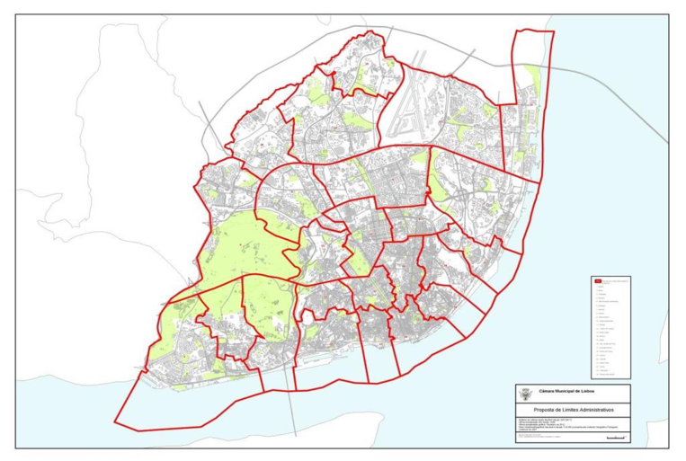
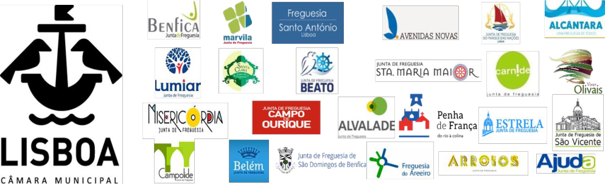

Slide 3
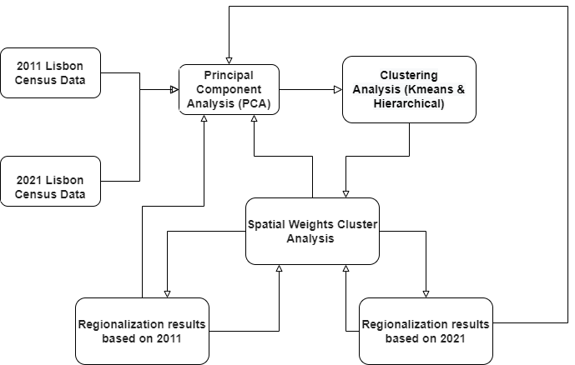
Conceptual model

Slide 4
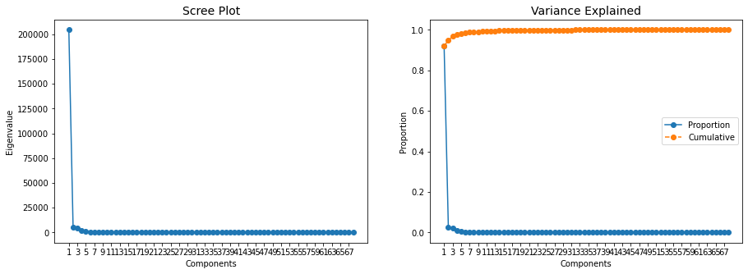
According to the Pareto principle, 20% of the number of principal components was used for the next step and PCA variables were established

Slide 5
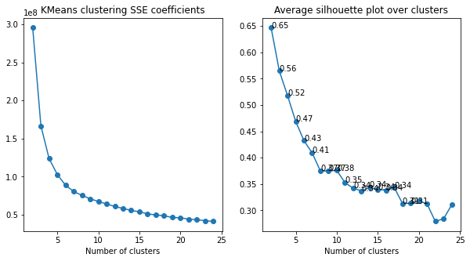
Selection of the number of clusters according to the elbow rule

Slide 6
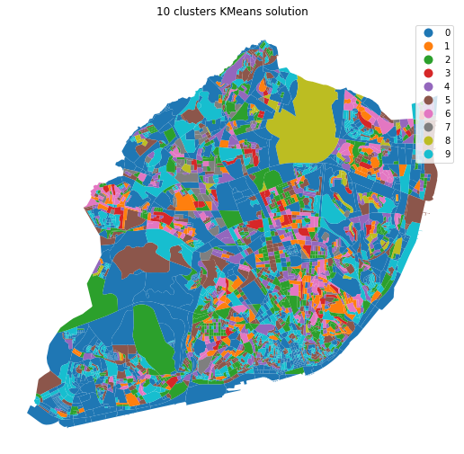

Slide 7
Generate clustering labels with four different spatial weights
#Queen
w_q = weights.contiguity.Queen.from_dataframe(df_pca[pca_feat_names+['geometry']])
#KNN
w_k = weights.KNN.from_dataframe(df_pca[pca_feat_names+['geometry']], k=4)
#Block
w_b = weights.util.block_weights(df_pca['FR11'].values)
#Unit
w_u = weights.set_operations.w_union(w_b, w_q)
 | wardwq | wardwknn | wardwblock | wardwunit
0 | 0 | 0 | 8 | 2
1 | 0 | 0 | 0 | 1
2 | 0 | 0 | 0 | 1
3 | 0 | 0 | 0 | 1
4 | 0 | 0 | 8 | 1

Slide 8
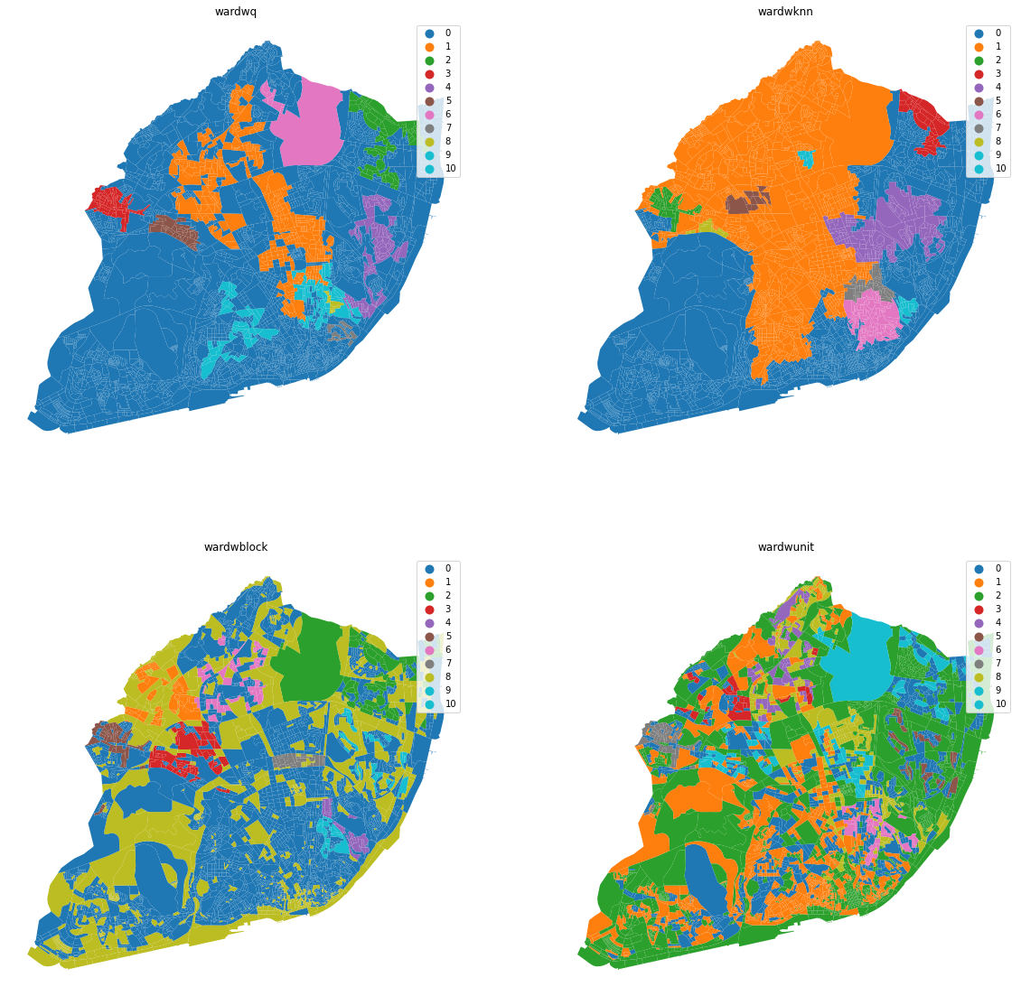

Slide 9
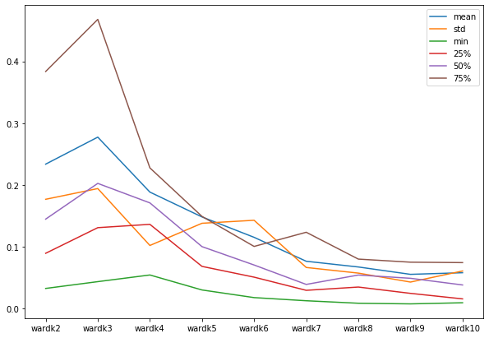
Calculate IPQ score for different number of KNN neighbors

Slide 10
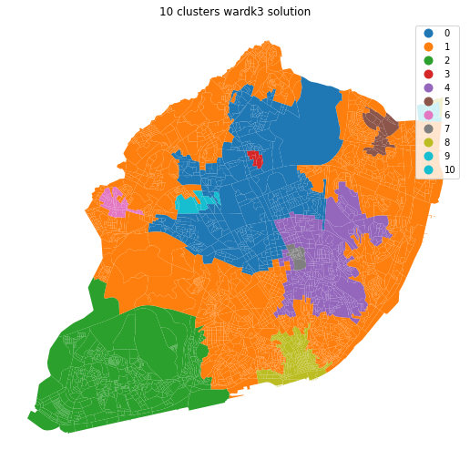

Slide 11
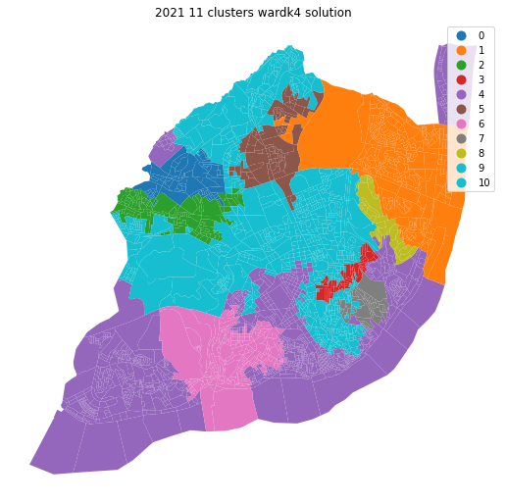

Slide 12
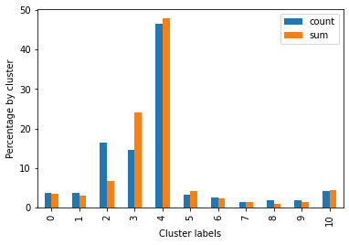

Slide 13
END!

